Slide 1
Lesson objective
Need whiteboards
Title: Substitution
Aim:
Identify and describe a pronumeral
Substitute and evaluate equations
Plan:
Review
Terminology
Substitution
PBiS focus:
Respect – hands up

Slide 2
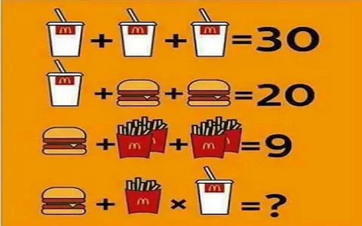
Can you solve this in 45 seconds?
Write your answer on the top of your page and we will come back to it.
End
1
2
3
4
5
6
7
8
9
10
11
12
13
14
15
16
17
18
19
20
21
22
23
24
25
26
27
28
29
30
31
32
33
34
35
36
37
38
39
40
41
42
43
44
45
Write down your answer if you can!

Slide 3
BIMDAS
B: ______________
I: ______________
M: ______________
D: ______________
A: ______________
S: ______________
When only m__________________ and d_____________
work _________ to __________
When only a__________________ and s_____________
work _________ to __________
Notes:
Worksheet 1

Slide 4

BIMDAS
(Brackets)
B: ______________
I: ______________
M: ______________
D: ______________
A: ______________
S: ______________
$${Indicies}^{2}$$
ultiplication
ivision
When only m__________________ and d_____________
work _________ to __________
left
right
Multiplication
Division
ddition
ubtraction
When only a__________________ and s_____________
work _________ to __________
Addition
left
right
Subtraction
Notes:
Worksheet 1

Slide 5
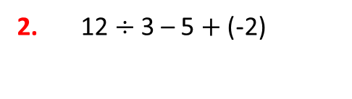
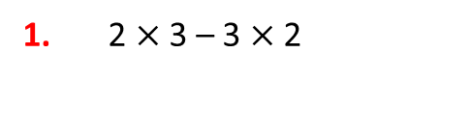
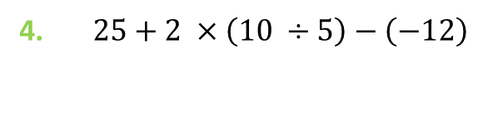
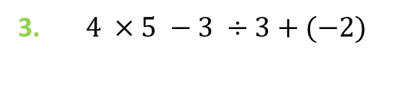
I do/we do
Brackets and indices.
Identify the multiplication and division.
Do the multiplication and division.
Deal with double signs.
Complete the addition / subtraction (left to right).
1. 2 $×$ 3 – 3 $×$ 2
3. $4 ×5 −3 ÷3+(−2)$
2. 12 $÷$ 3 – 5 $+$ (-2)
4. $25+2 ×\left(10 ÷5\right)−\left(−12\right)$

Slide 6

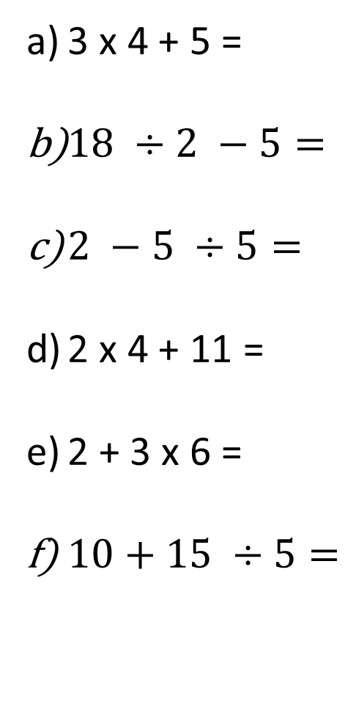

BIMDAS practice: exercise books
3 x 4 + 5 =
$18 ÷2 −5=$
$2 −5 ÷5=$
2 x 4 + 11 =
2 + 3 x 6 =
$10+15 ÷5=$
$20 −10 x 2=$
$1 x 20 ÷5=$
$15 −7 x 3=$
$18 ÷\left(2+5\right)=$
$\left(11 −9\right) x 5=$
$\left(19 −10\right)÷3=$
$\left(10 −8\right) x (10 ÷2)$=
$18 −\left(10 ÷2\right) x 3=$
$25 ÷\left(11 −6\right) x 4=$
$2+\left(18 ÷9\right)−8=$
$2^{2}+\left(11 x 2\right)−7=$
$22 ÷\left[\left(2+5\right)+4\right]=$

Slide 7
The word is
Pronumeral:
A letter or symbol used to represent a number.

Slide 8
The word is
Evaluate:
To evaluate an expression or to substitute values means to replace each pronumeral in an expression with a number to obtain a final value.

Slide 9
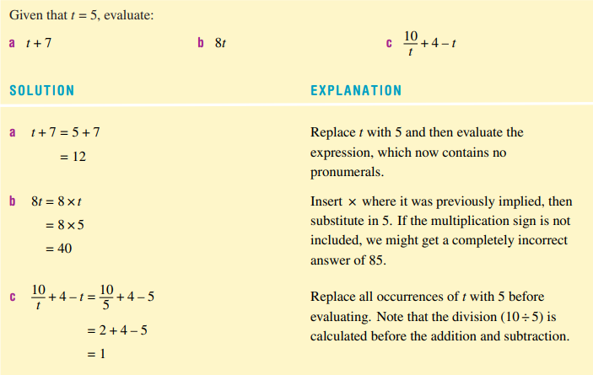

Slide 10


Substitution
I do
We do
Given than x = 6
X + 20 =
5x =
$20 ÷x+7=$
Given that y = 4
10 – y =
3y =
$\frac{8}{y}+10=$

Slide 11

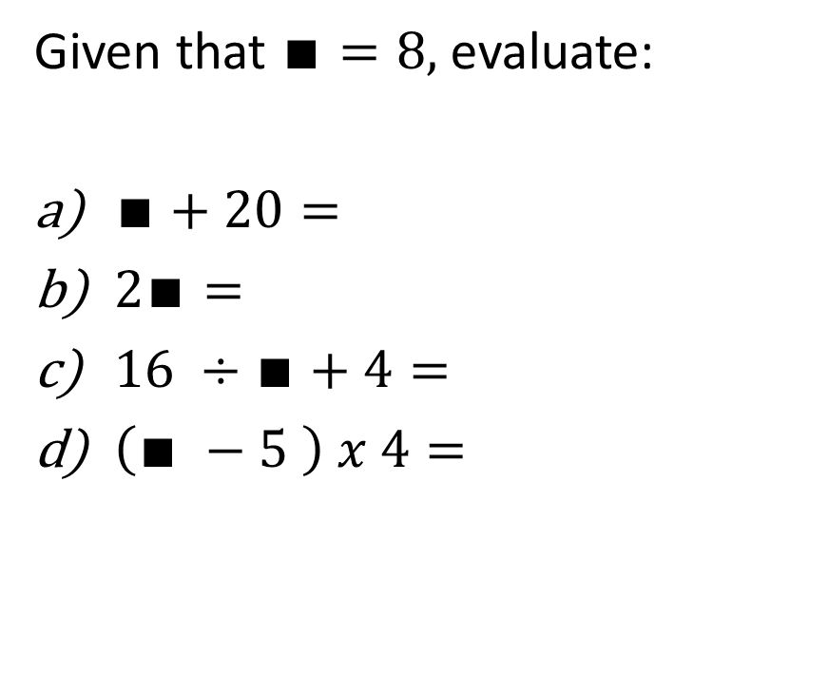
You do: whiteboards
Given that $∎=8,$evaluate:
$∎+20=$
$2∎=$
$16 ÷∎+4=$
$\left(∎ −5 \right) x 4=$
Given that h = 3, evaluate:
$h+11=$
$5h=$
$h x h+5=$
$18 ÷\left(h+6\right)=$

Slide 12
Individual practice
Sum fun
“interesting facts” – 10
“order in the court” – 32

Slide 13
Reflection
Aim:
Identify and describe a pronumeral
Substitute and evaluate equations

